Slide 1
Programming Assignment 5
Building/Elevator Simulation
Scott Arnette - Cory Elswick - Bryan Smith

Slide 2
Assignments
SimBuilding Class - Bryan Smith
Floor Class - Cory Elswick
Elevator Classes - Scott Arnette

Slide 3
SimBuilding Class
Represents the "Building" in the simulation
Responsible for
tracking total average wait time of users
stepping through each simulation iteration
Implements the Floor and Elevator classes and uses them to function.
Made up of 2 linkedLists, one for elevators and one for floors.
Uses linkedListIterators to traverse the linkedLists
4 methods: step(), run(), LoadElevators(), and load floors.

Slide 4
SimBuilding Class Problems
Biggest Issue: The Human Element
Would crash after the 32nd step.
Due to not resetting the floor iterator after reaching the last floor
Iterator would try to go forward to the 34th floor which did not exist.

Slide 5
Floor Class
People are generated here into a queue to simulate arriving at an elevator and waiting
People are removed based upon when an elevator arrives and if it can hold more people
The wait times of the people and the number of people who boarded are kept track of to use for averaging

Slide 6
Floor Class: Major Methods
arriveAt(int) - this method randomly generates 0-3 people and enters them into the queue with a wait time of 0
leaveAt(int) - removes x elements from queue by a call to deleteFloorQueue
deleteFloorQueue() - removes the first element of the queue and adds the wait time of deleted elements to boardedWait and then increments boardedPeople
QueueWaitIncrement() - increments wait time of all elements in the queue

Slide 7
Elevator Class
Main purpose is to move to each floor and pick up and let off people.
Does so by keeping track of several variables: maxCapacity, currentLoad, movingUp, lastLoadNumPeople, etc.
Also uses several methods and derived classes to work to perform necessary tasks.

Slide 8
Elevator Class: Methods
Implemented methods will allow for the elevator to work with the floor and simBuilding classes to simulate the entire process.
loadPeople: Allows for "people" randomly generated from the floors to get onboard the elevator and keeps a running count of people that have boarded the elevator.
unloadPeople: Randomly generates a number of people to unload on each floor.

Slide 9
Elevator Class: Derived Classes
The third essential function used to move the elevator exists as a pure virtual method in the elevator class and is only defined in subclasses allElevators, evenElevators, and oddElevators.
The move function is designed to check whether or not a floor is available to move to and then move the elevator up or down as necessary by changing a boolean value: movingUp.

Slide 10
Elevator Class: Move Function
For oddElevators and allElevators, the floors begin at 1 and move to only odd floors (for odd) and each floor (for all).
For evenElevators, the floor begins at 2 and move only to even numbered floors.
The move function uses a linked list to check if the next floor is real or a null value. If real, the floor moves up. If null, the goingUp value flips to false and the elevator begins moving down. The opposite is also true.

Slide 11
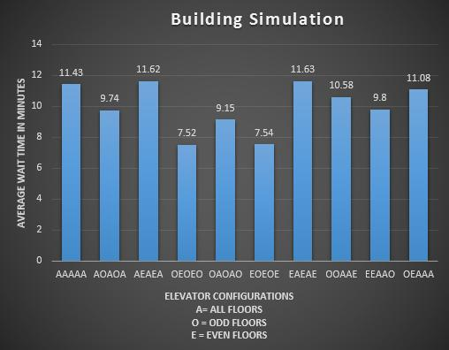
Results
10 simulations of 10 different elevator configurations of a 33 floor, 5 elevator building for 30 minutes (60 iterations)
Clear winners are either OEOEO or EOEOE

Slide 12
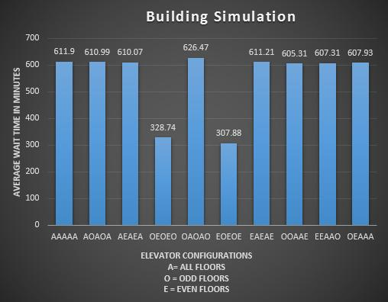
Results: For Fun
10 simulations of 10 different elevator configurations of a 33 floor, 5 elevator building for 24 hours (2880 iterations)
Same winners by a large margin.

